Slide 1
Auburn Campus tour
-Function Explanations
App Developers :YoonhaKim, JungpyoHong
This app is designated to use Android OS

Slide 2
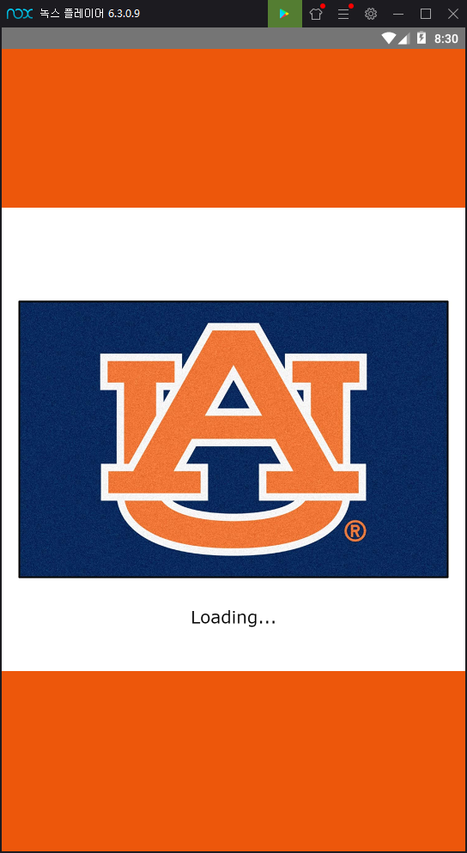
Loading-Page
Show Auburn logo with picture that represent Auburn university.
After loading is done, go to main page

Slide 3
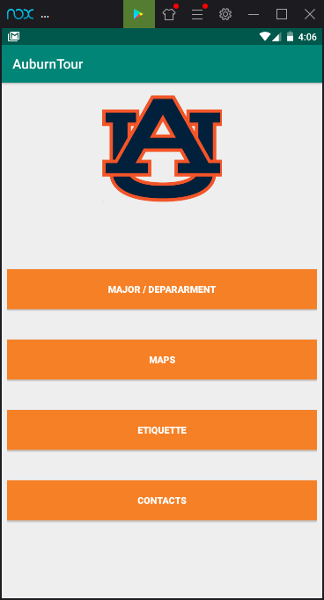
Description -
Main Page - 4 Options Button
When you clicked to each Button,
Move to Major Information/Information Department
Move to : Maps Information
Move to : Etiquette information
Move to:Contact Info

Slide 4
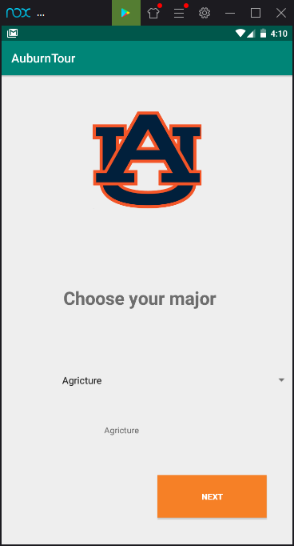
Major/Departments page
Users choose their interesting major
Ex: I choose Computer Science
And, press the Next button

Slide 5
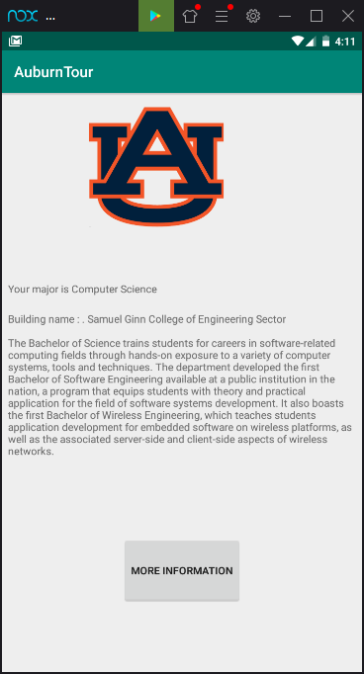
Major/Departments page - information page
Display the chosen major information
If you like to know more information about the, curriculum, press More Information button

Slide 6
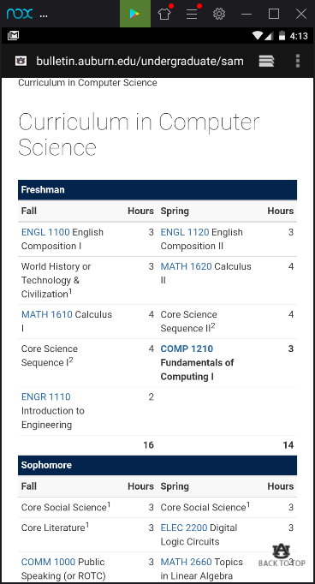
More Information page
: It will opens new window connected to Internet explorer
It shows curriculum of major

Slide 7
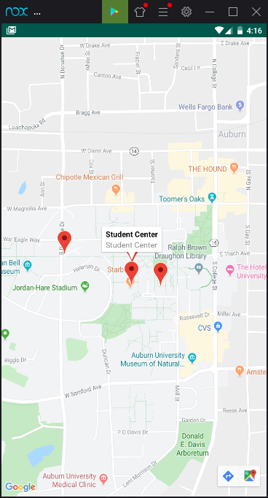
Maps page
Google Maps API - Show the Auburn University Maps
We puts several department locations pointers
When the student click pointer, information of department is showed up

Slide 8
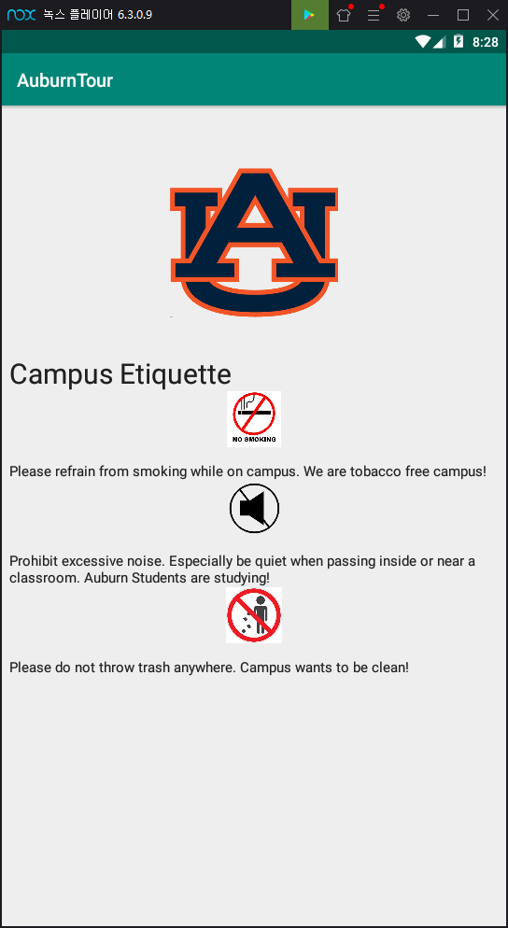
Etiquette page
It will show the campus etiquette during the campus tour and campus rule

Slide 9
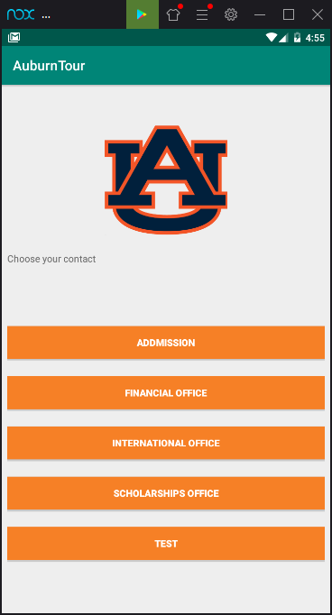
Contact Info page
User press button, which you want contact office.
For example, I pressed the test office then, it will move email writing page
For example : I pressed Test button

Slide 10
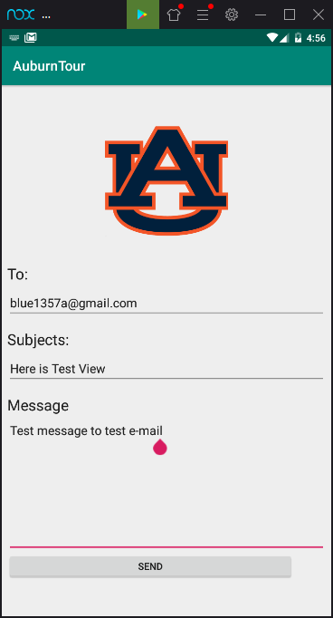
Contact Info page - Write email
Once you choose office button, it directly automatic sets the each e-mail address. Then you can write down subjects and message. After you write down the letter, then press send button. It will connect to your mail application.

Slide 11
Contact Info page - Write email
Once you choose office button, it is directly automatic set the each e-mail address. Then you can write down subjects and message. After you write down the letter, then press send button. It will connect to your mail application.

Slide 12
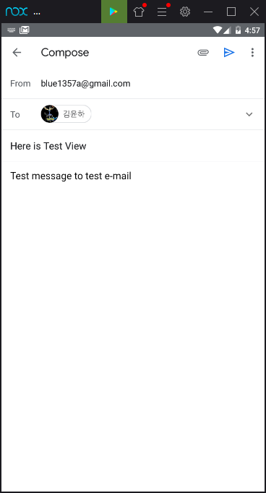
Then, it will copy automatically your message which you write down. So, you can send message to office

Slide 13
Thank you for using
Our Auburn Tour
Application

